Slide 1
Enhancing Reliability and Quality of Drilled Shafts Through TIP Testing
&
TIP Acceptance Criteria
Matthew Silveston, P.E. Terracon Consultants Inc.
&
George Piscsalko, Pile Dynamics Inc.

Slide 2
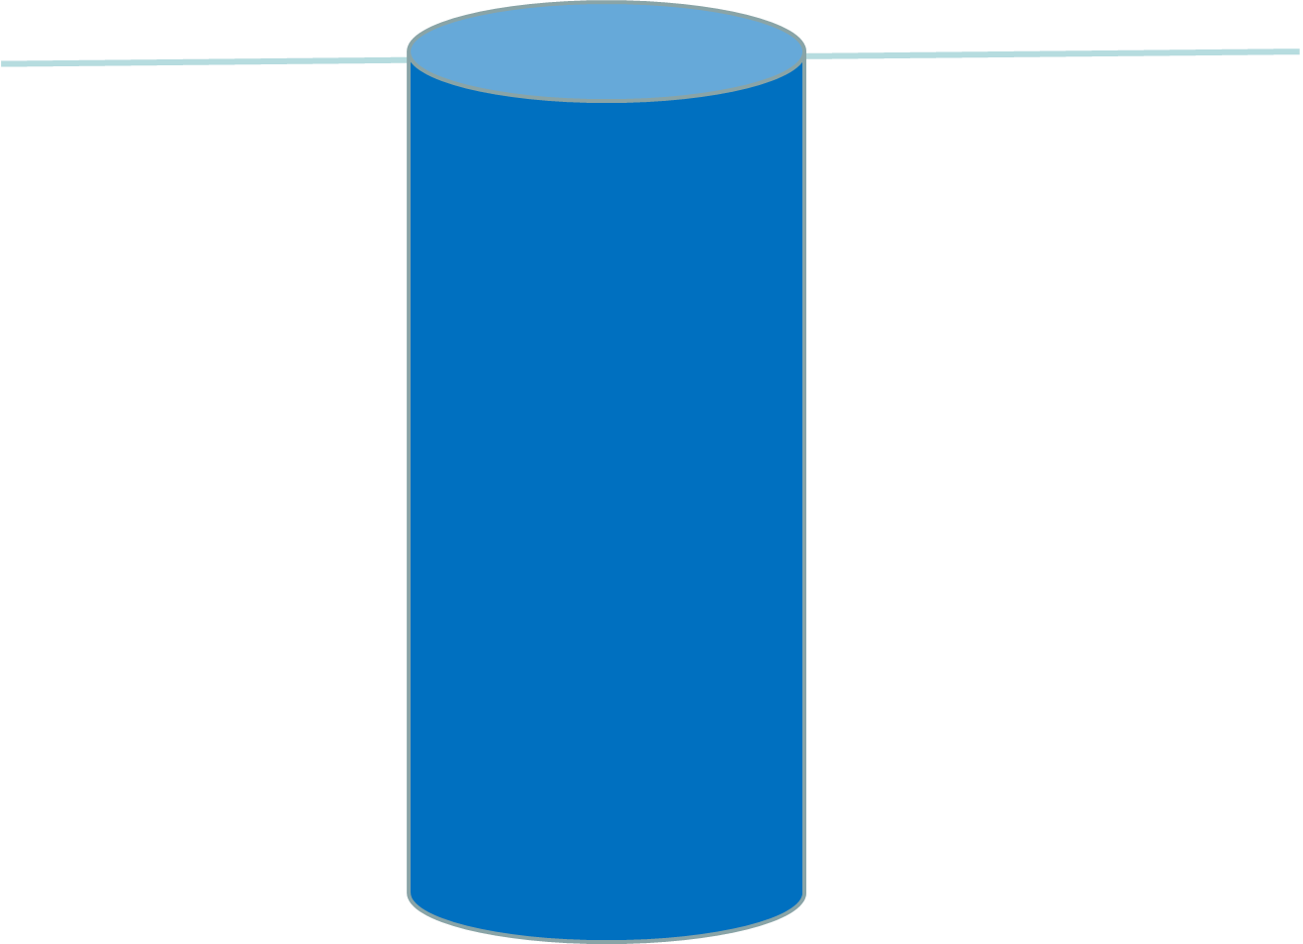

Slide 3
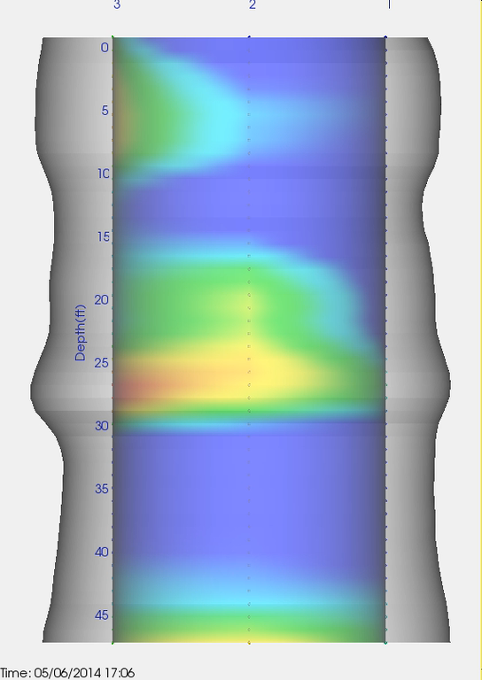

Slide 4
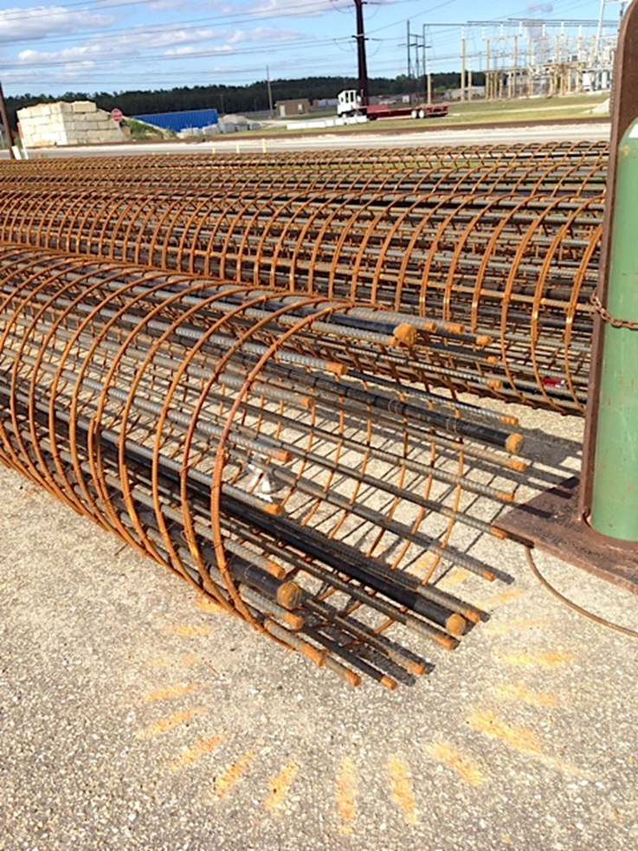

Slide 5
Thermal Integrity Profiling Theory
Slice

Slide 6
Thermal Integrity Profiling Theory
Cage Shift
1
1
4
2
4
2
3
3

Slide 7
Thermal Integrity Profiling
Anomaly
1
1
1
4
2
4
4
2
2
3
3

Slide 8
Thermal Integrity Profiling
Anomaly
1
1
4
2
4
2
3
3

Slide 9
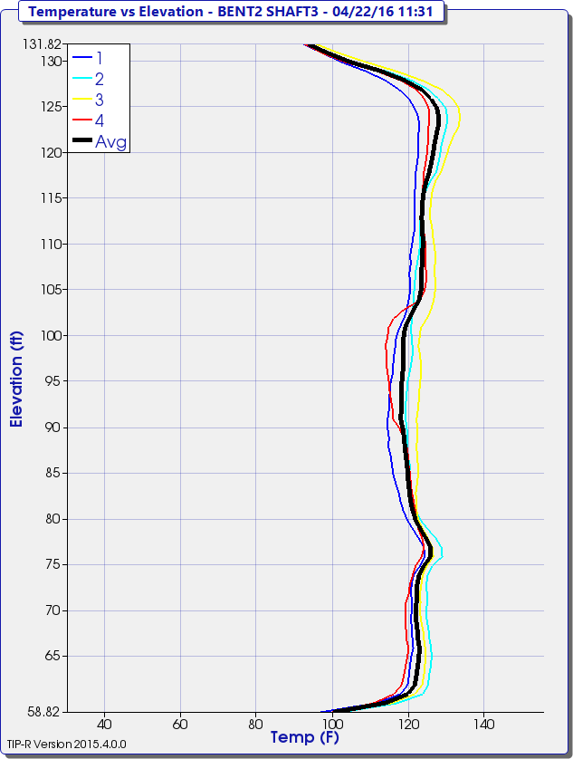
Thermal Integrity Profiling
Ideal Results

Slide 10

Thermal Wire
Example 1
42” dia with 38” rock socket
27 ft long
NY/NJ area

Slide 11
Thermal Wire Setup
Example 1
Wire 1
Wire 4
Wire 2
North
Wire 3

Slide 12
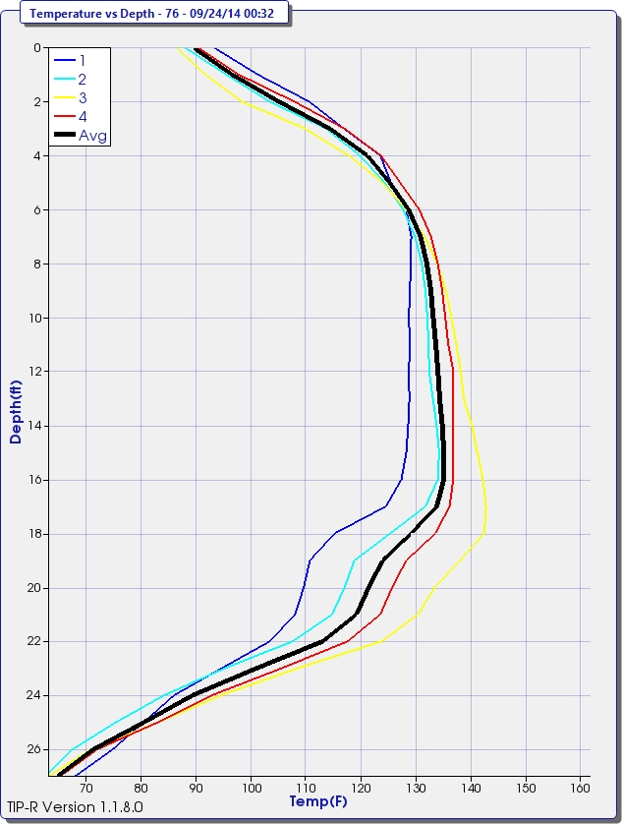
Thermal Analysis
Example 1
Cage Shift
Rock socket
Soft Bottom
Ambient Soil Temp 55º

Slide 13
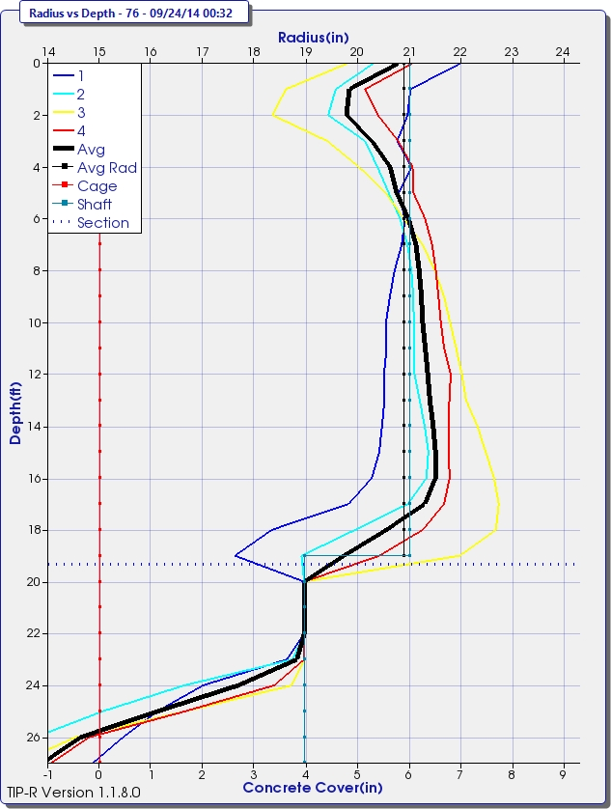
Thermal Analysis
Example 1
Neck
Cage
Cage Shift
Rock socket
Soft Bottom

Slide 14
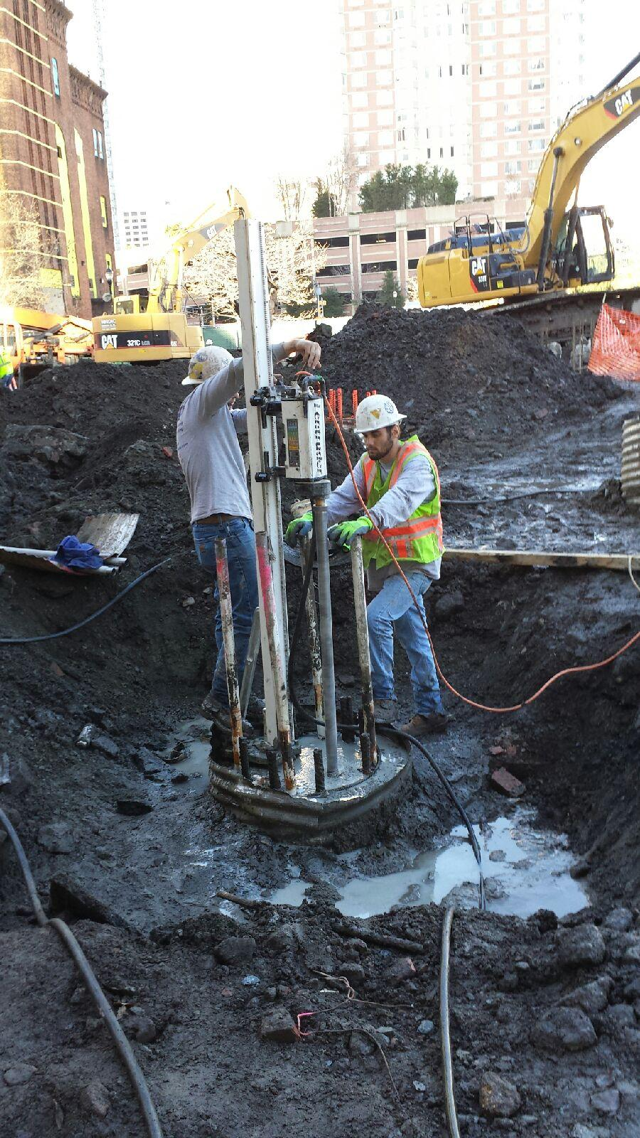
Thermal Analysis
Example 1
NY/NJ Pier 76

Slide 15
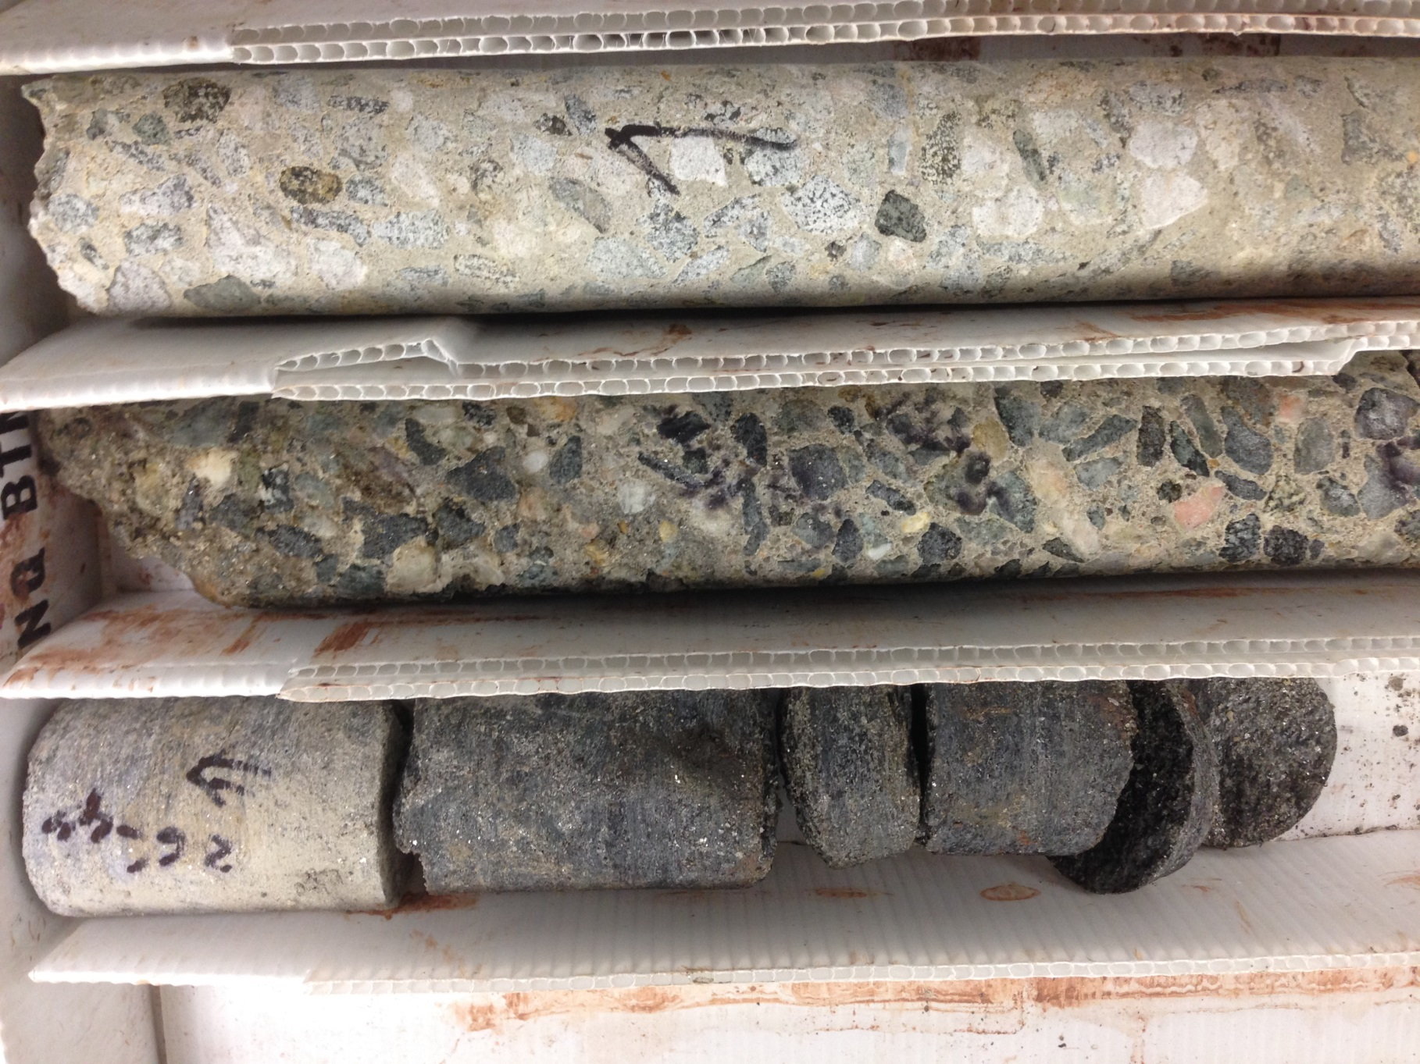
Thermal Analysis
Example 1
8,000 psi
1,600 psi
NY/NJ Pier 76

Slide 16
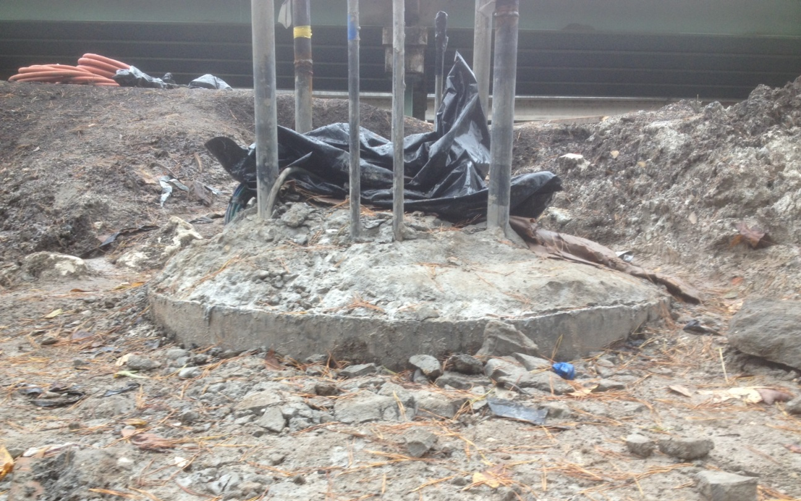
Thermal Probe
Example 2
Little River
Tallahassee

Slide 17
Concrete Data
Example 2
36.03 yd³ actual
34.97 yd³ theoretical

Slide 18
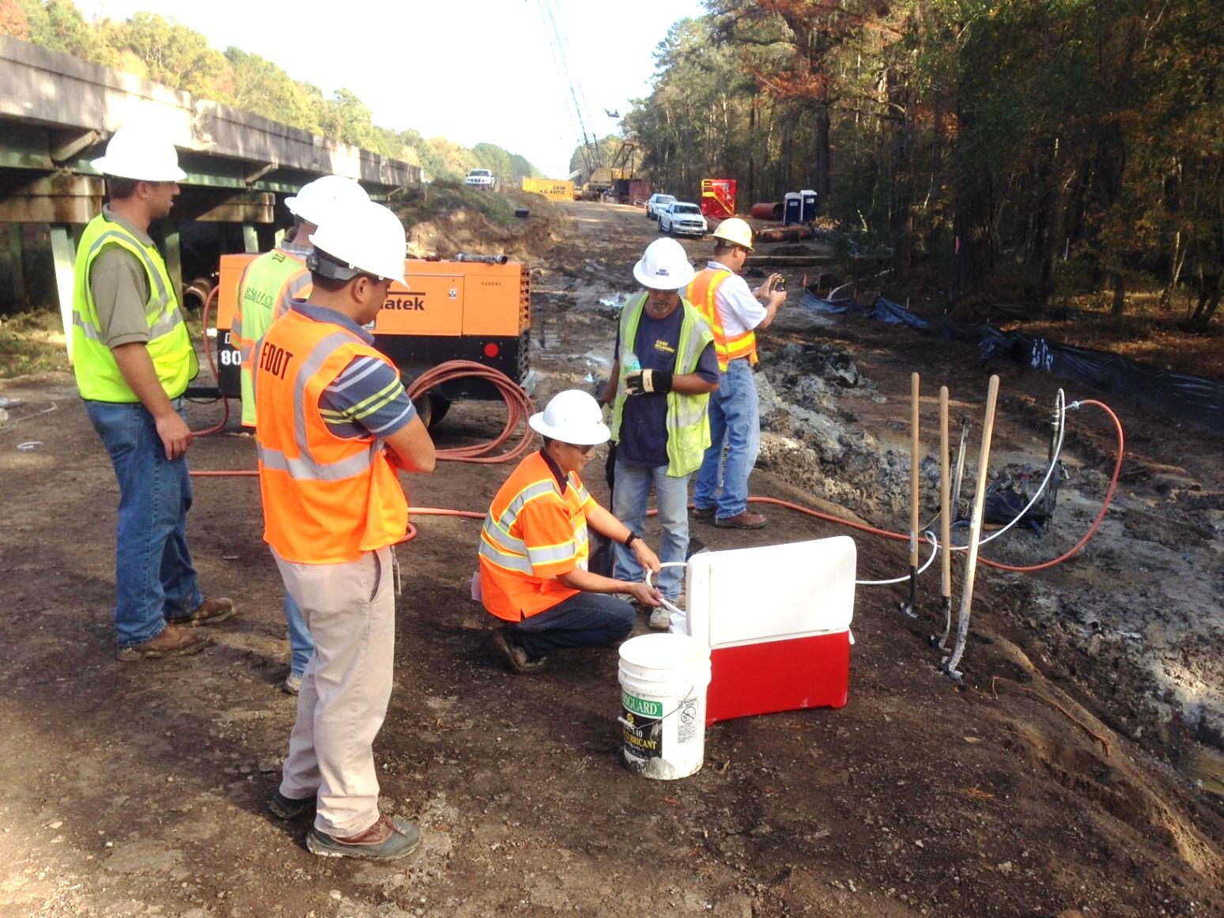
Thermal Probe
Example 2

Slide 19
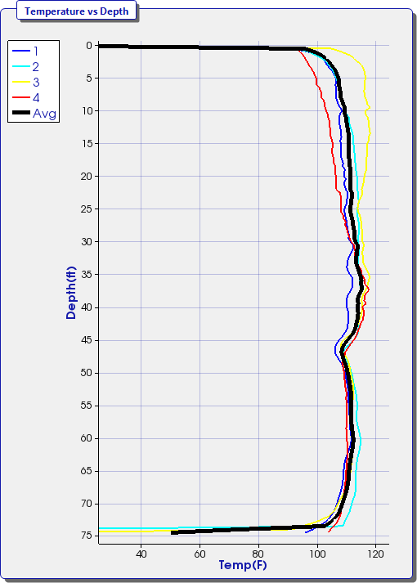
Thermal Results
Example 2
Loose SiSa to hard SiCl
Cage Shift
Bottom of Casing
Weathered Limestone
Anomaly

Slide 20
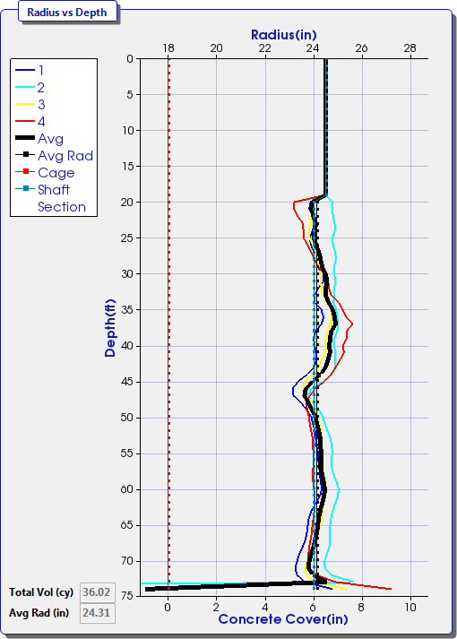
Thermal Results
Example 2
Cage Shift tubes 2&4
Anomaly

Slide 21
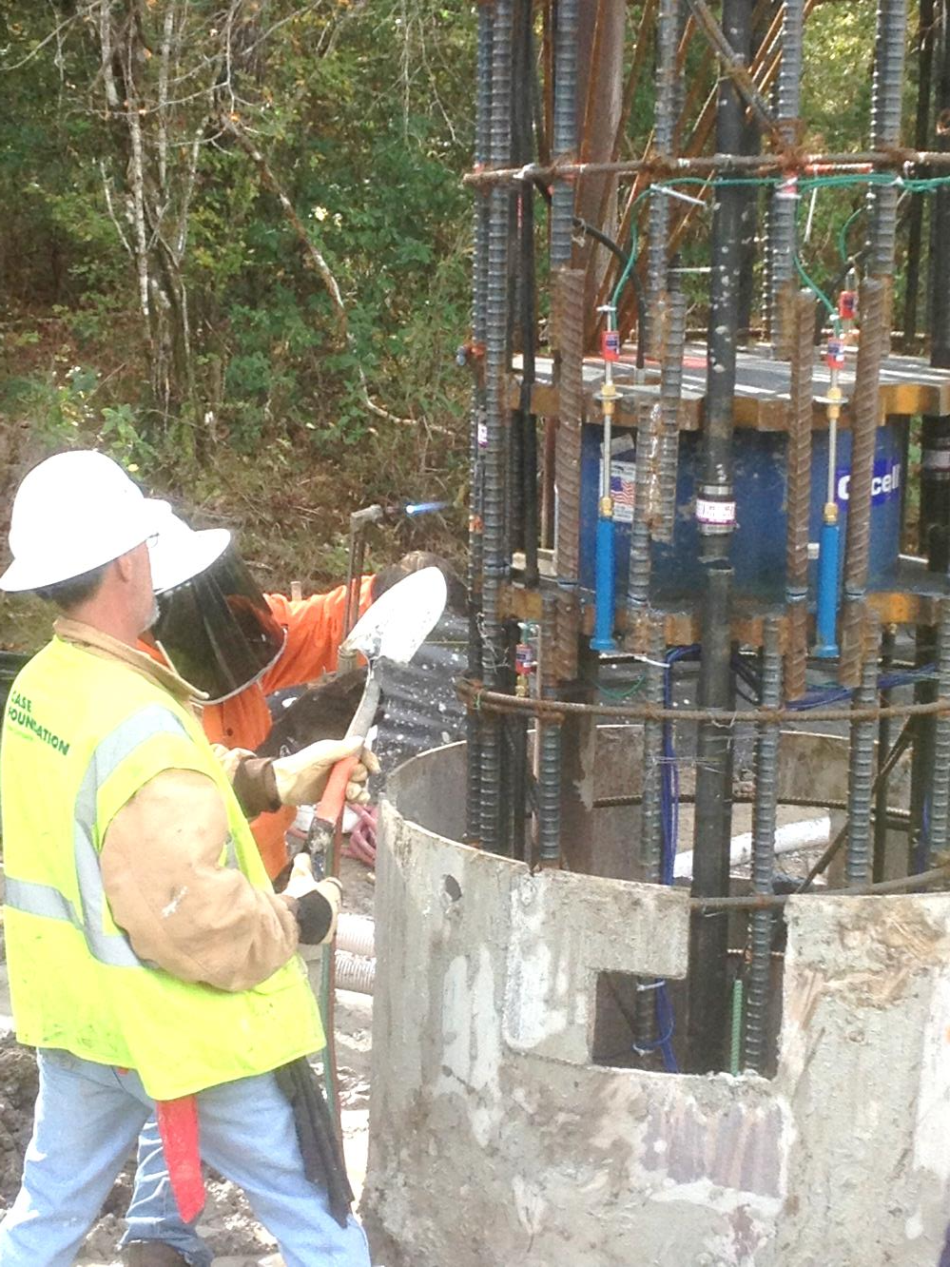
Thermal Results
Example 2
Anomaly

Slide 22
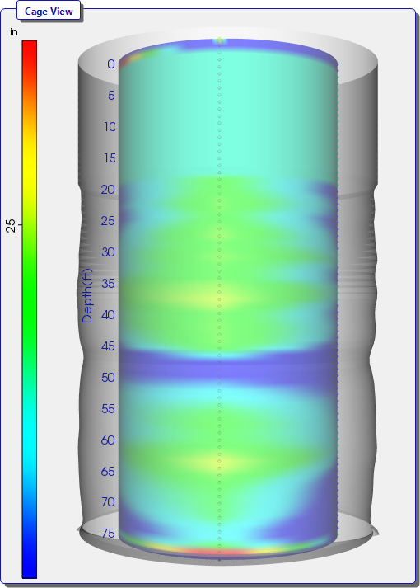
Thermal Model of Shaft
Example 2
Osterberg Cell

Slide 23
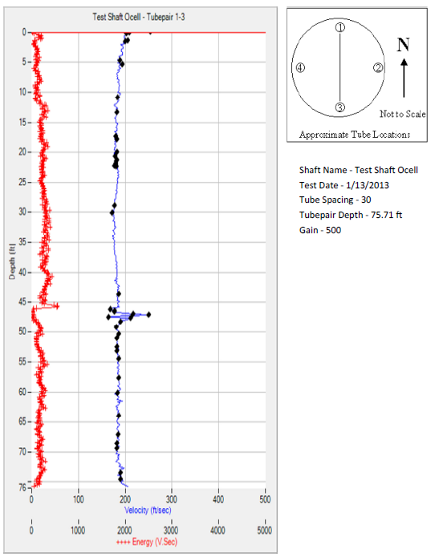
CSL vs Thermal
Example 2
Cage Shift
O-cell
Anomaly

Slide 25
Acceptance Criteria
Load carrying requirements can be controlled by:
  Geotechnical side shear
  Structural bending
  Compression
These are directly related to:
  Circumference surface area of the shaft
  Moment of inertia
  Cross sectional area
Radius Reduction approach will affect each differently:
  Reduction has linear relation to circumference
  Reduction has fourth power relation to moment of inertia
  Reduction has squared relation to area

Slide 26
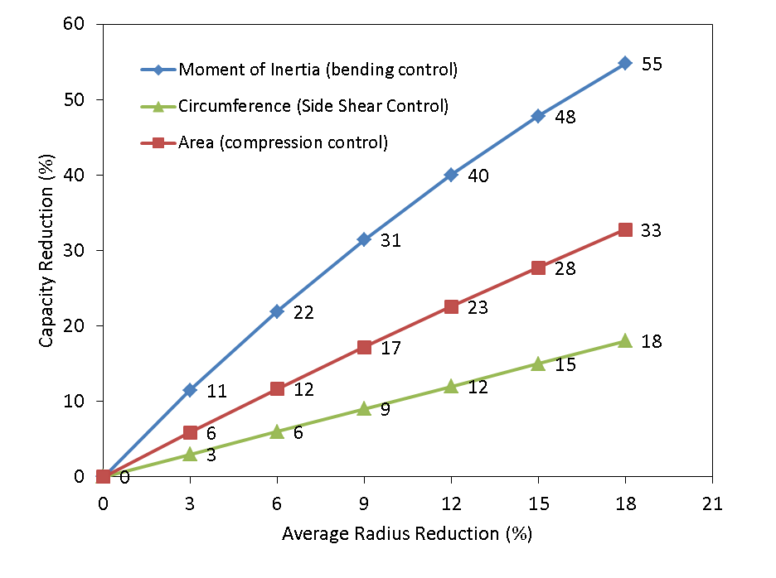
Radius Reduction vs. Capacity Reduction

Slide 27
Cover Loss Considerations on Local Radius Reductions vs. Shaft Diameter

Slide 28
Acceptance Criteria
Radius Reduction | Bending Capacity Loss | Compression Capacity Loss | Side Shear Reduction | Cover Loss (4 inch cover, 6ft dia. shaft)
3% | 11% | 6% | 3% | 1.08in
6% | 22% | 12% | 6% | 2.16in
>6% | >22% | >12% | >6% | >2.16in
Satisfactory (S)
0 to 6% Radius Reduction and
Local Cover Criteria Met
Anomaly (A) Requiring further evaluation
Radius Reduction > 6% or
Local Cover Criteria Not Met

Slide 29
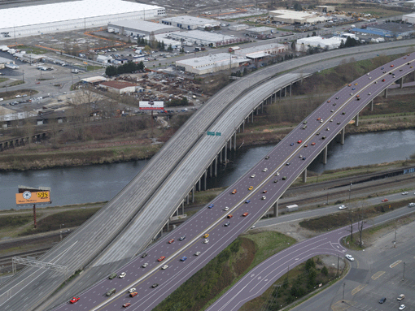
I-5 Bridge over Puyallup River
Tacoma, Washington

Slide 30
TIP Case History
Wet cast Shaft in Washington State
118” diameter
  10 TIP wires installed
Cage Diameter 102”
126’ shaft length
TIP testing begins immediately after casting
  Data recorded during pour as well as cure
Data recorded for approximately 90 hours after casting
Shaft peak temperature occurs approximately 40 hours after casting
Shaft analysis done at time of one half peak temperature (20 hours)

Slide 31
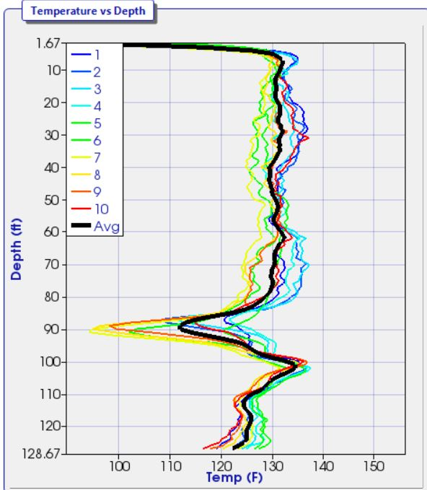
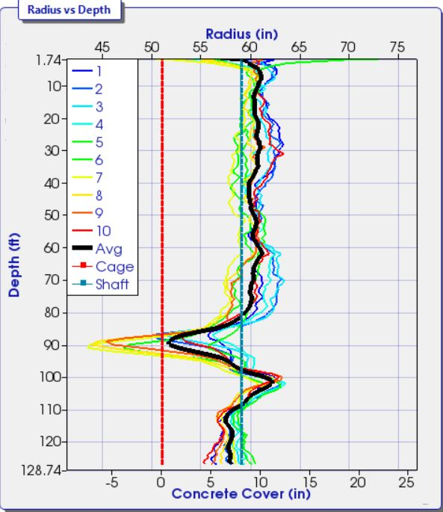
TIP Data at Peak Temperature

Slide 32
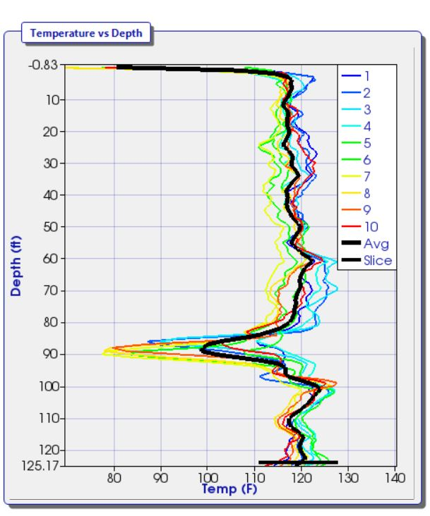
TIP Data at time of one half Peak Temperature
Temperature drop is approximately 42 °F between average shaft temperature and local temperature near wires 7, 8, and 9

Slide 33
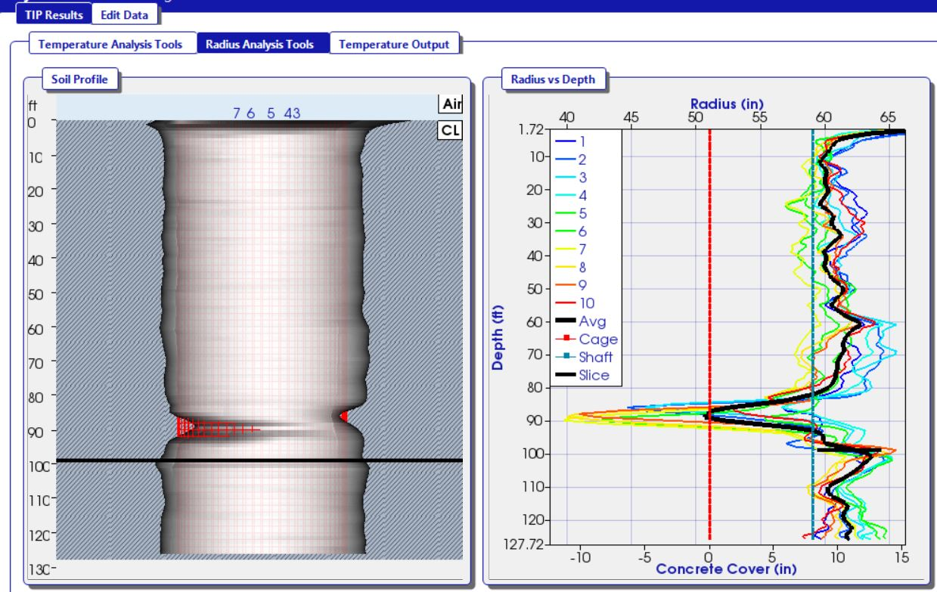
TIP Data at one half Peak Temperature

Slide 34
TIP Results and Acceptance Criteria
Shaft shows a local reduction near wires 6 through 9
  Design radius = 59 inches
  Local effective radius at wires 7 & 8 = 40 inches
  Reduction in Local Radius = 32.2%
    Clearly greater than 6% Reduction in our Criteria
  Cover is also reduced to zero in these regions
    Anomaly extends inside the reinforcing cage
    Below minimum cover requirement
  Shaft fails BOTH the radius reduction criteria AND the cover criteria
  This is considered an anomaly which requires further evaluation
  Coring is done in several locations in the shaft

Slide 35

6
5
7
4
8
Coring Locations
3
9
2
10
1
Notes:
First core was located 18 inches inside the rebar cage and angled towards the cage. Near the depth of the washed out region the core was approximately 6 inches inside the rebar cage.
Zone was hydro-blasted, camera was ran down core holes, and pressure grouting was performed

Slide 36
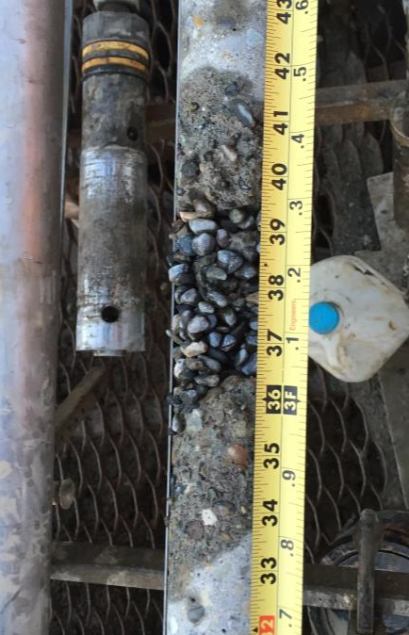
Coring Results at approximately 90’ depth
Coring result close to wires 7 and 8, where largest reduction occurred
Coring confirms TIP test results
Zone was hydro-blasted and pressure grouting was performed

Slide 37
Conclusions
TIP is being used frequently for testing drilled shafts and ACIP piles
TIP can evaluate the area outside the reinforcing cage
An acceptance criteria based upon cover and radius is possible with TIP
The minimum cover specs for a project can be verified
Radius reductions greater than 6% can be easily detected by TIP, alerting the project engineer to further evaluate this anomalous zone

Slide 38

Thank You

